Slide 1
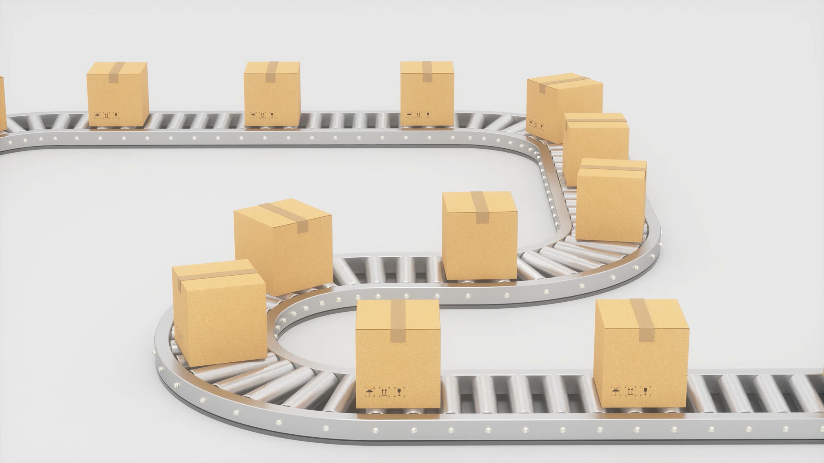
A presentation of Delivery backlogs of Streamline Logistics Solution
A report on the Analysis Conducted by Favour Olooku.

Slide 2
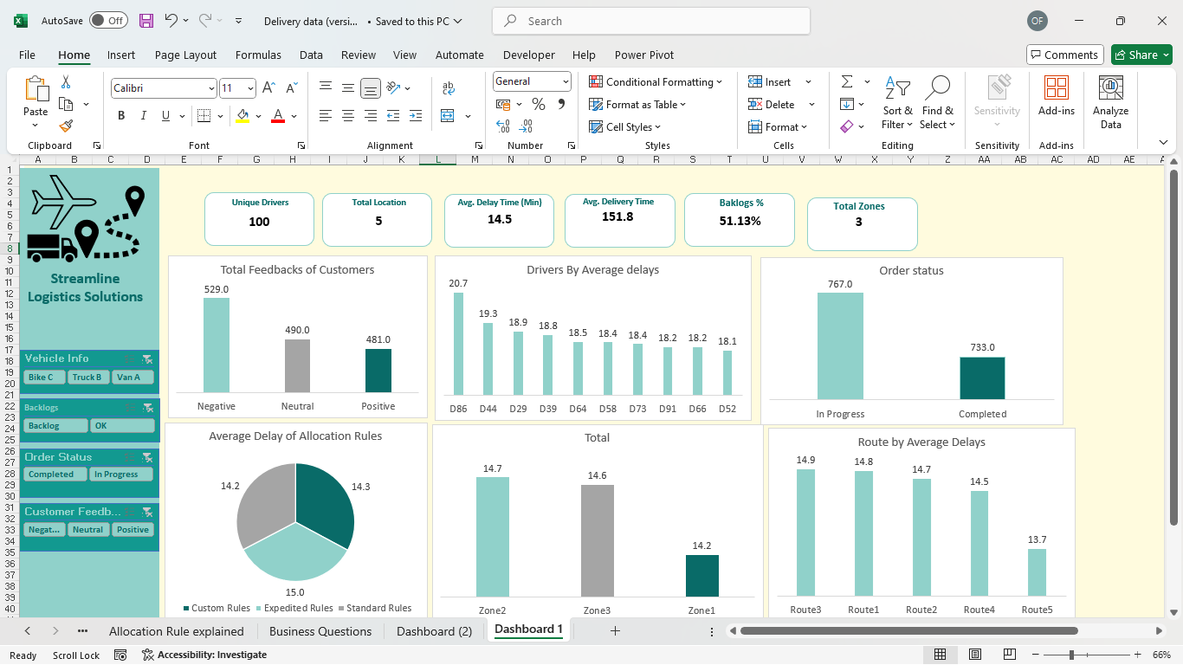

Slide 3

Findings
KPI’s
Total Drivers: 100
There are about a 100 drivers which Indicates a relatively large fleet of drivers, which is beneficial for distribution flexibility.
Total Locations: 5 A moderate delivery network that might be regionally concentrated.
Average Delay Time (Min): 14.5 minutes This is a manageable average delay, but optimization opportunities exist.
Average Delivery Time: 151.8 minutes These suggests that deliveries are taking around 2.5 hours; this might be long depending on the geographical span and target SLAs.
Backlogs %: 51.13% This is a red flag. Over half of the deliveries are experiencing backlog issues. This significantly impacts service quality and customer satisfaction.
Total Zones: 3 Indicates segmentation of the delivery regions, possibly for load balancing.

Slide 4
Findings
Customer Feedback (Total Feedbacks of Customers):
There are more negative feedback than positive, indicating potential dissatisfaction with service quality, delays, or communication.
Drivers by Average Delays:
Drivers D86 (20.7 mins) and D44 (19.3 mins) show the highest delay times. The remaining drivers are relatively consistent (18.1–18.9 mins).
Order Status
In Progress: 767, Completed: 733
There is almost equal split, but the high number of ongoing tasks may contribute to bottlenecks and backlog.
Minimal variance in delays across zones suggests that zone design isn’t the primary bottleneck, but minor optimization is still possible.
There are differences in delays are small, but consistently higher delays on Route 3 suggest possible traffic congestion, longer distance, or inefficient routing.

Slide 5
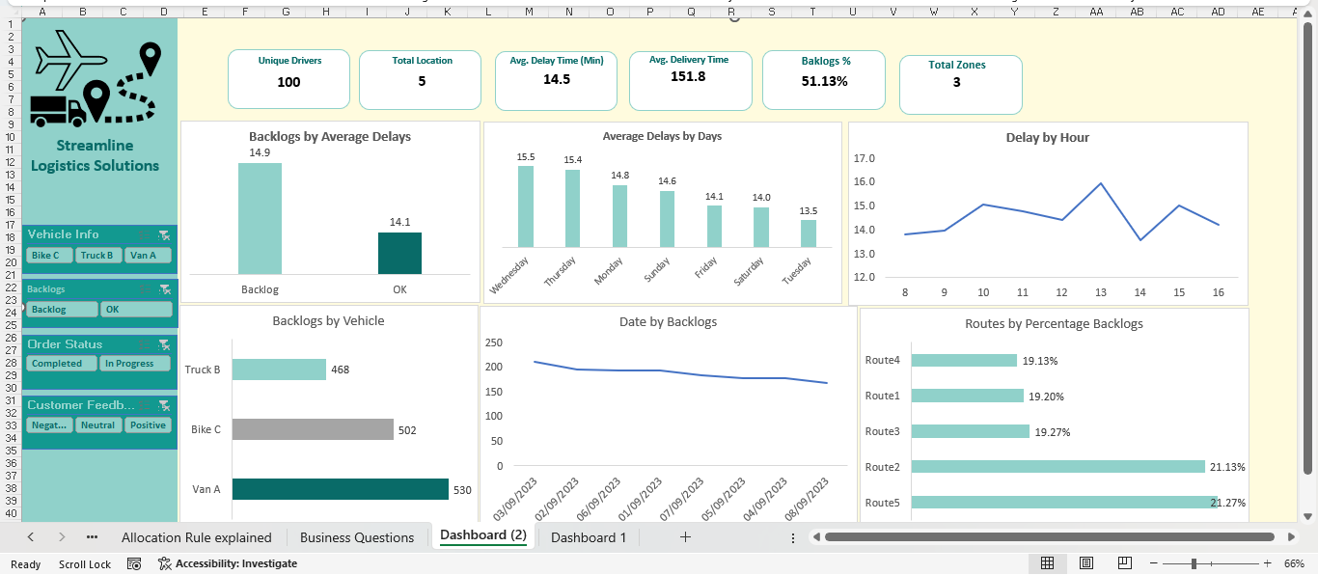

Slide 6
Findings
Midweek delays imply increased delivery pressure or reduced capacity. There may be misalignment between demand volume and workforce/resource availability midweek. For days like Wednesday Thursday which happen to have Peak delays while Tuesday has the lowest delays.
Delays rise toward midday around 13:00 pm likely due to traffic congestion, driver fatigue, or batching inefficiencies. Morning deliveries are more efficient between the hours of 8:00 Am – 10:00Am.
Van A has the highest backlogged volume. This could be due to overscheduling, urban routes with high stop density, or longer delivery distances compared to bikes or trucks which happen to have Lower backlogged volumes.
All routes have similarly high backlog percentages, with Route 5 and Route 2 being the worst. This may indicate systemic routing inefficiencies or widespread operational strain across the entire network.

Slide 7
Recommendation
High negative feedback is likely tied to backlogs and delays, to tackle this set up proactive communication for delays.
Also Consider post-delivery surveys and offer compensation for major delays.
Use demand forecasting to allocate drivers, vehicles, and delivery times based on historical backlog trends (e.g., peak Wednesdays/Thursdays).
Shift some deliveries to lower-traffic days like Tuesday or Saturday.
Focus on morning delivery slots to avoid midday congestion and reduce delays.
Audit high-delay routes (Route 3, Route 1) using traffic data.
Re-sequence stops or redesign delivery clusters using route optimization software.
Although not shown in this dashboard, integrating driver-specific delay patterns can help reassign drivers to more suitable zones/routes.
Offer performance incentives for consistently low-delay deliveries.
Introduce automated customer notifications for delayed orders and estimated time of arrival.

Slide 8
Conclusion
In Conclusion, while delay times are not extreme, the backlog rate of over 50% is a serious operational risk. The dashboard suggests that the issues are less about individual delay magnitude and more about inefficient allocation rules, timing, and route planning. By applying data-driven improvements across these areas, Streamline Logistics Solutions can significantly enhance performance, reduce backlogs, and improve customer satisfaction.

